Slide 1
Targets for the day
Basic descriptive statistics
The need for Inferential statistics
Probability Density functions and Cumulative Distribution Functions
The Normal Distribution
Working with the Normal Distribution
Sudo apt-get update
Sudo apt-get install r-base
Sudo apt-get install r-base-dev

Slide 2
The need for inferential statistics and the techniques taught therein
Notes:
> library(openintro)
> library(tidyverse)
> data(‘ncbirths’)
# take summary of weights grouped by if mother was # a smoker or not
> ncbirths %>% group_by(habit) %>% summarise(avgweight = mean(weight, na.rm = T))
# take a random sample of 100 observations from the # set, and do the same
> sampbirthss <- sample_n(ncbirths, 100)
> sampbirths %>% group_by(habit) %>% summarise(avgweight = mean(weight, na.rm = T))
# Take 10 such samples, and repeat
> for (i in 1:10) {
+ sampmoms <- sample_n(ncbirths, 100)
+ sampmoms %>% group_by(habit) %>% summarise(avgweight = mean(weight, na.rm = T)) %>% print()
+ }

Slide 3
To our rescue: The Central Limit Theorem
For our purpose, the CLT states that the distribution of averages of iid variables (properly normalized) becomes that of a standard normal, as the sample size increases.

Slide 4
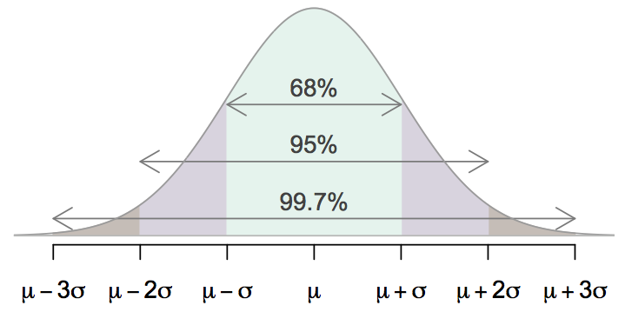
68-95-99.7 Rule
For nearly normally distributed data,
about 68% falls within 1 SD of the mean,
about 95% falls within 2 SD of the mean,
about 99.7% falls within 3 SD of the mean.
It is possible for observations to fall 4, 5, or more standard deviations away from the mean, but these occurrences are very rare if the data are nearly normal.

Slide 5
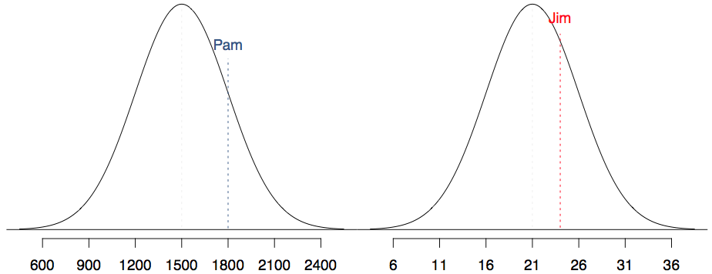
SAT scores are distributed nearly normally with mean 1500 and standard deviation 300. ACT scores are distributed nearly normally with mean 21 and standard deviation 5. A college admissions officer wants to determine which of the two applicants scored better on their standardized test with respect to the other test takers: Pam, who earned an 1800 on her SAT, or Jim, who scored a 24 on his ACT?

Slide 6
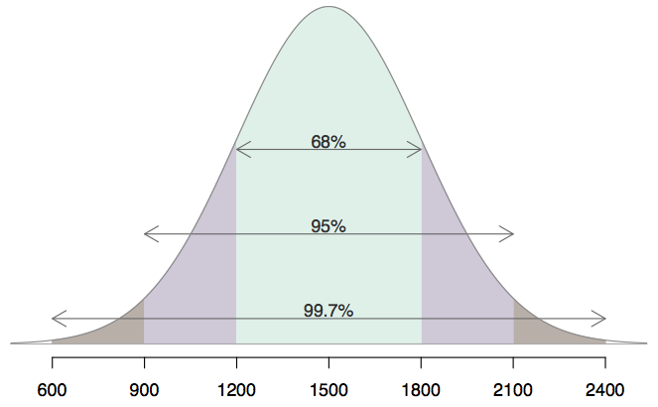
Describing variability using the 68-95-99.7 Rule
SAT scores are distributed nearly normally with mean 1500 and standard deviation 300.
~68% of students score between 1200 and 1800 on the SAT.
~95% of students score between 900 and 2100 on the SAT.
~$99.7% of students score between 600 and 2400 on the SAT.

Slide 7
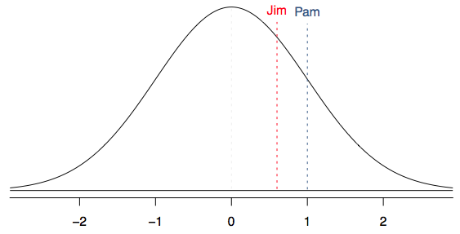
Standardizing with Z scores
Since we cannot just compare these two raw scores, we instead compare how many standard deviations beyond the mean each observation is.
Pam's score is (1800 - 1500) / 300 = 1 standard deviation above the mean.
Jim's score is (24 - 21) / 5 = 0.6 standard deviations above the mean.

Slide 8
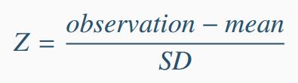
Standardizing with Z scores (cont.)
These are called standardized scores, or Z scores.
Z score of an observation is the number of standard deviations it falls above or below the mean.
Z scores are defined for distributions of any shape, but only when the distribution is normal can we use Z scores to calculate percentiles.
Observations that are more than 2 SD away from the mean (|Z| > 2) are usually considered unusual.

Slide 9
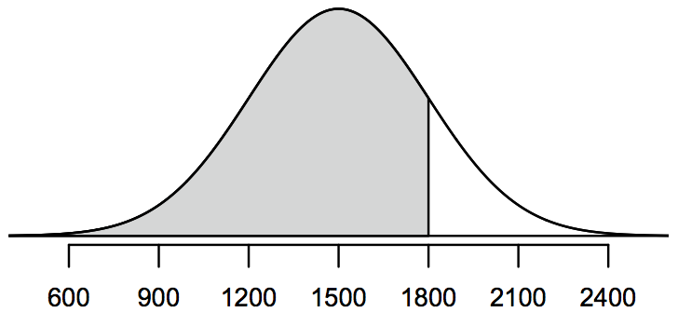
Percentiles
Percentile is the percentage of observations that fall below a given data point.
Graphically, percentile is the area below the probability distribution curve to the left of that observation.

Slide 10
Calculating percentiles -
using computation
There are many ways to compute percentiles/areas under the curve. R:

Slide 11
Quality control
At Heinz ketchup factory the amounts which go into bottles of ketchup are supposed to be normally distributed with mean 36 oz. and standard deviation 0.11 oz. Once every 30 minutes a bottle is selected from the production line, and its contents are noted precisely. If the amount of ketchup in the bottle is below 35.8 oz. or above 36.2 oz., then the bottle fails the quality control inspection. What percent of bottles have less than 35.8 ounces of ketchup?

Slide 12
Quality control
At Heinz ketchup factory the amounts which go into bottles of ketchup are supposed to be normally distributed with mean 36 oz. and standard deviation 0.11 oz. Once every 30 minutes a bottle is selected from the production line, and its contents are noted precisely. If the amount of ketchup in the bottle is below 35.8 oz. or above 36.2 oz., then the bottle fails the quality control inspection. What percent of bottles have less than 35.8 ounces of ketchup?
Let X = amount of ketchup in a bottle: X ~ N(µ = 36, σ = 0.11)

Slide 13
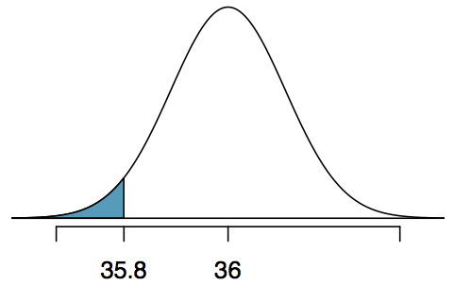
Quality control
At Heinz ketchup factory the amounts which go into bottles of ketchup are supposed to be normally distributed with mean 36 oz. and standard deviation 0.11 oz. Once every 30 minutes a bottle is selected from the production line, and its contents are noted precisely. If the amount of ketchup in the bottle is below 35.8 oz. or above 36.2 oz., then the bottle fails the quality control inspection. What percent of bottles have less than 35.8 ounces of ketchup?
Let X = amount of ketchup in a bottle: X ~ N(µ = 36, σ = 0.11)

Slide 14
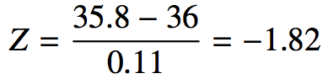
Quality control
At Heinz ketchup factory the amounts which go into bottles of ketchup are supposed to be normally distributed with mean 36 oz. and standard deviation 0.11 oz. Once every 30 minutes a bottle is selected from the production line, and its contents are noted precisely. If the amount of ketchup in the bottle is below 35.8 oz. or above 36.2 oz., then the bottle fails the quality control inspection. What percent of bottles have less than 35.8 ounces of ketchup?
Let X = amount of ketchup in a bottle: X ~ N(µ = 36, σ = 0.11)

Slide 15
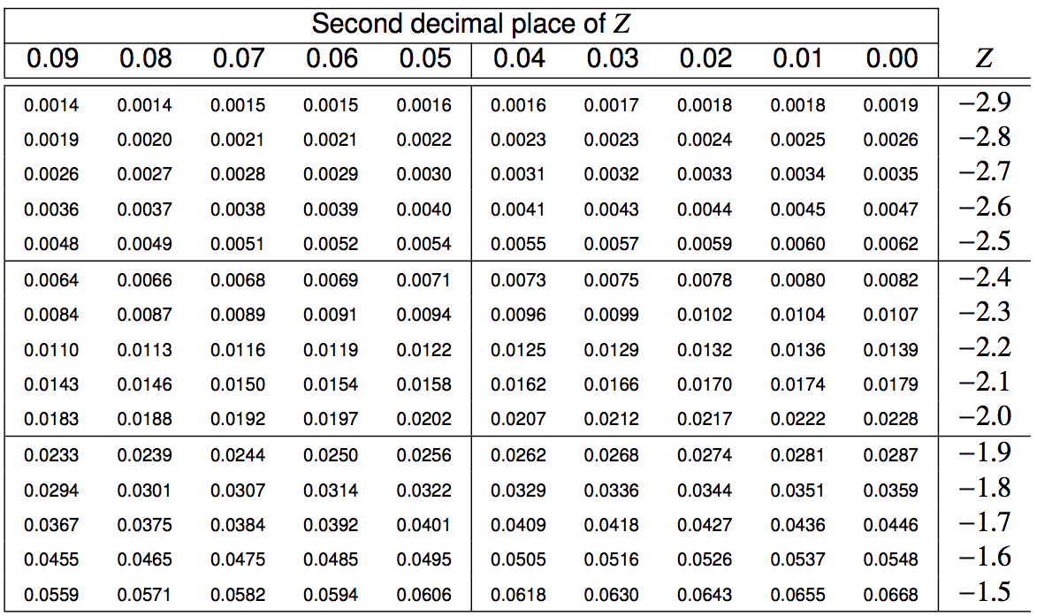
Finding the exact probability - using the Z table

Slide 16
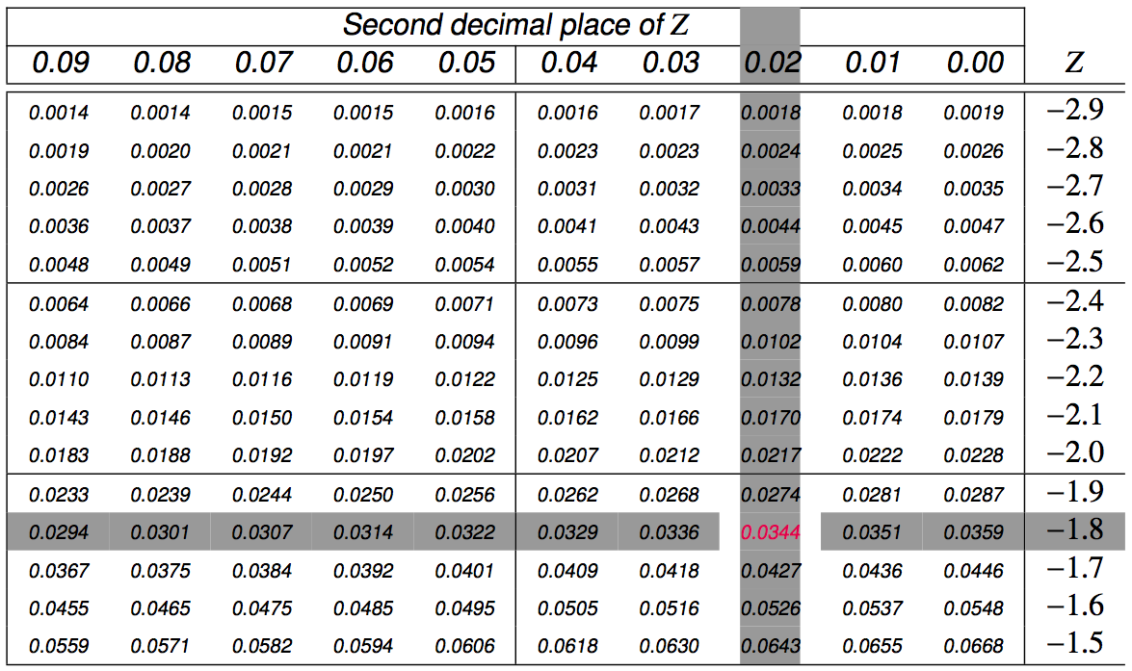
Finding the exact probability - using the Z table

Slide 17
Practice
What percent of bottles pass the quality control inspection?
1.82%
3.44%
6.88%
93.12%
96.56%

Slide 18
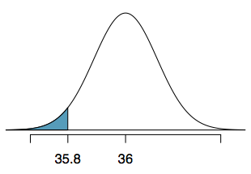
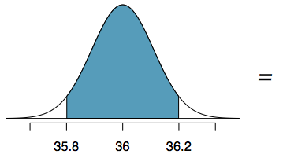
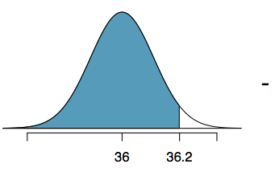


Practice
What percent of bottles pass the quality control inspection?
1.82%
3.44%
6.88%
93.12%
96.56%

Slide 19
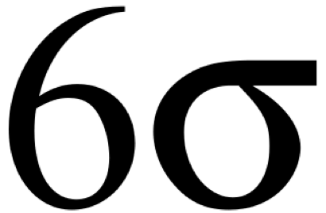
Six sigma
The term six sigma process comes from the notion that if one has six standard deviations between the process mean and the nearest specification limit, as shown in the graph, practically no items will fail to meet specifications.
http://en.wikipedia.org/wiki/Six_Sigma

Slide 20
Finding cutoff points
Body temperatures of healthy humans are distributed nearly normally with mean 98.2ºF and standard deviation 0.73ºF. What is the cutoff for the lowest 3% of human body temperatures?

Slide 21
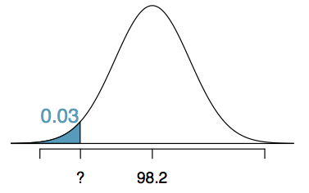
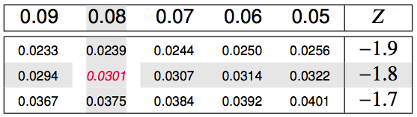

Finding cutoff points
Body temperatures of healthy humans are distributed nearly normally with mean 98.2ºF and standard deviation 0.73ºF. What is the cutoff for the lowest 3% of human body temperatures?
Mackowiak, Wasserman, and Levine (1992), A Critical Appraisal of 98.6 Degrees F, the Upper Limit of the Normal Body Temperature, and Other Legacies of Carl Reinhold August Wunderlick.

Slide 22
Practice
Body temperatures of healthy humans are distributed nearly normally with mean 98.2ºF and standard deviation 0.73ºF. What is the cutoff for the highest 10% of human body temperatures?
A. 97.3ºF C. 99.4ºF
B. 99.1ºF D. 99.6ºF

Slide 23
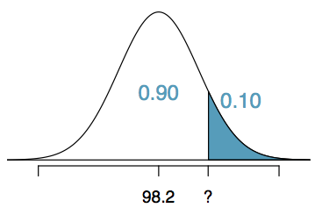
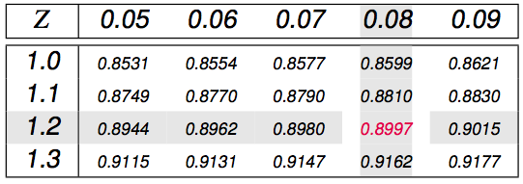

Practice
Body temperatures of healthy humans are distributed nearly normally with mean 98.2ºF and standard deviation 0.73ºF. What is the cutoff for the highest 10% of human body temperatures?
A. 97.3ºF C. 99.4ºF
B. 99.1ºF D. 99.6ºF

Slide 24
Facts about the normal density
Approximately 68%, 95%, and 99% of the normal density lies within 1, 2 and 3 standard deviations from the mean, respectively
-1.28, -1.645, -1.96 and -2.33 are the 10th, 5th, 2.5th and 1st percentiles of the standard normal distribution respectively
By symmetry, 1.28, 1.645, 1.96 and 2.33 are the 90th, 955h, 97.5th and 99th percentiles of the standard normal distribution respectively

Slide 25
Practice
Assume that the number of daily ad clicks for a company is (approximately) normally distributed with a mean of 1020 and a standard deviation of 50. What’s the probability of getting more than 1160 clicks in a day?
How many standard deviations is it away from the mean?
Notes:
> pnorm(1160, mean = 1020, sd = 50, lower.tail=FALSE)
> pnorm(2.8, lower.tail=FALSE)

Slide 26
Practice
Assume that the number of daily ad clicks for a company is (approximately) normally distributed with a mean of 1020 and a standard deviation of 50. What number of daily ad clicks would represent the one where 75% of days have fewer clicks (assuming days are independent and identically distributed)?
Notes:
> qnorm(0.75, mean = 1020, sd = 50)

Slide 27
Empirical demonstration: The Central Limit Theorem
Notes:
> library(openintro)
> data('yrbss')
> pop_mean <- mean(yrbss$physically_active_7d, na.rm = T)
> pop_sd <- sd(yrbss$physically_active_7d, na.rm = T)
> samp_params <- yrbss %>% rep_sample_n(size = 100, reps = 15000, replace = T) %>% summarise(avgactivity = mean(physically_active_7d, na.rm = T), sigma = sd(physically_active_7d, na.rm = T))
> mean(sampmeans$avgactivity)
> ggplot(data = sampmeans, aes(x = avgactivity)) + geom_histogram()

